Slide 1
Distinct mechanism of µ receptor activation by SR-17018 confers G-protein signalling bias
Dr. Samuel Singleton
Postdoc TGH lab, University of Dundee
SSingleton001@dundee.ac.uk

Slide 2
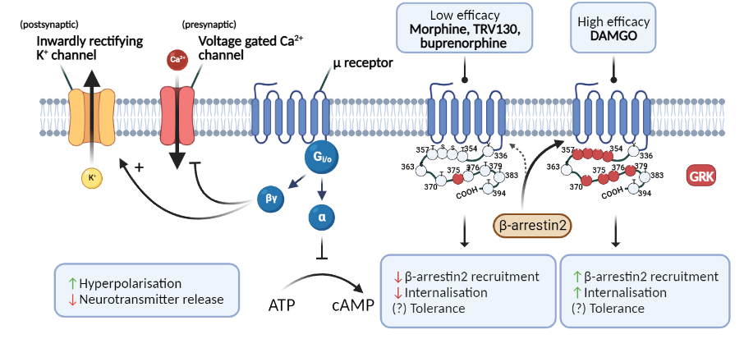
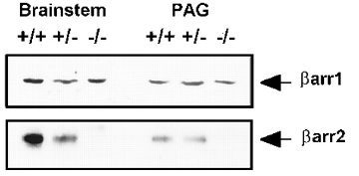
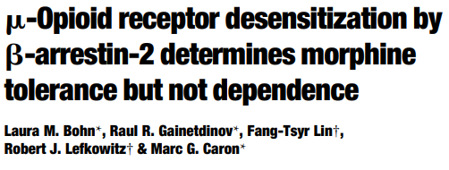
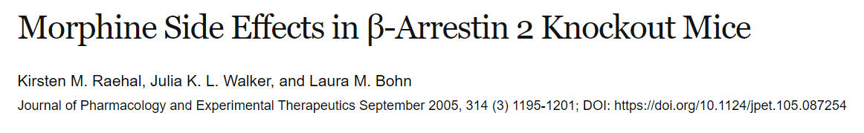
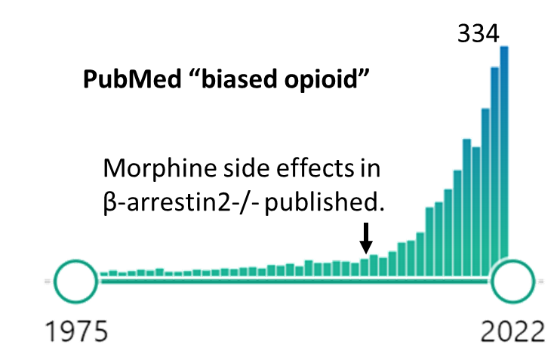
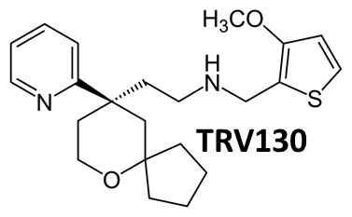
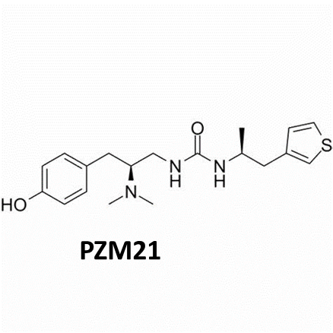
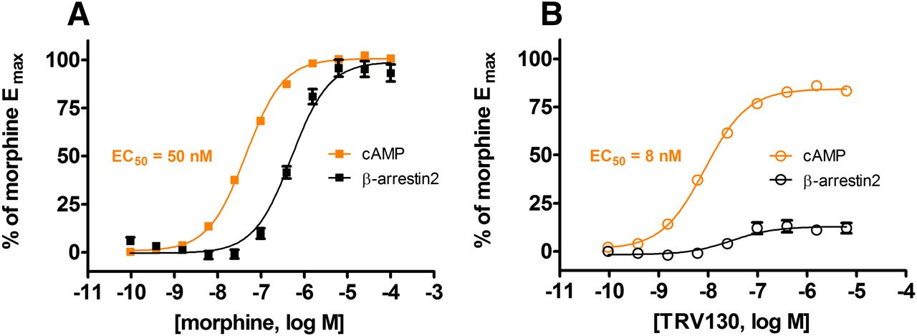
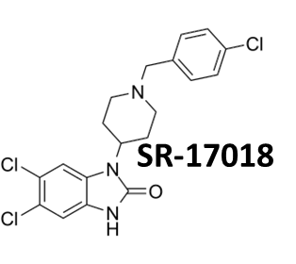
Background
Improved analgesia with reduced RD, tolerance and OIC

Slide 3
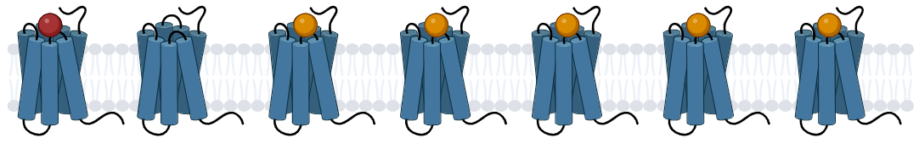
Additional limitations associated with in vitro models
Spare receptors
Spare receptors
Partial agonists are able to achieve maximum responses in amplified pathways
(with fractional occupancy) to give the appearance of full efficacy.
This often leads to the false impression of signalling bias.

Slide 4
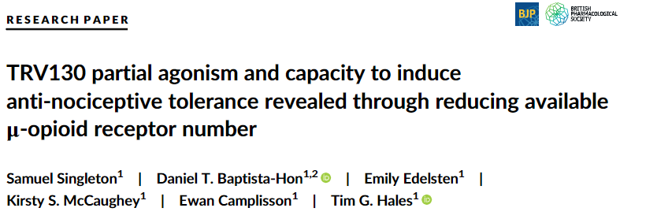
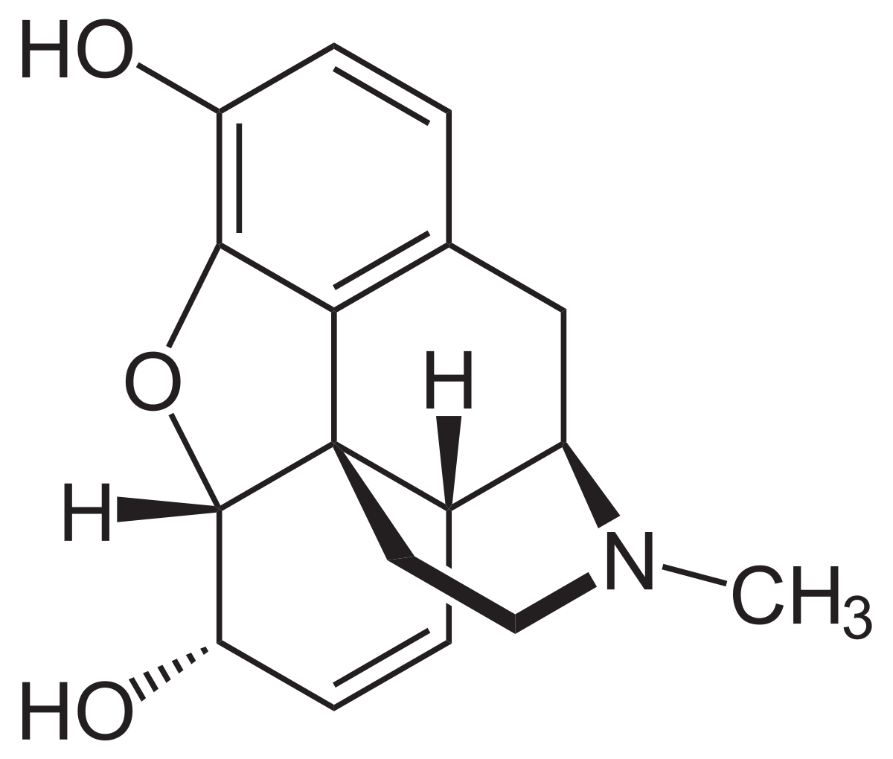
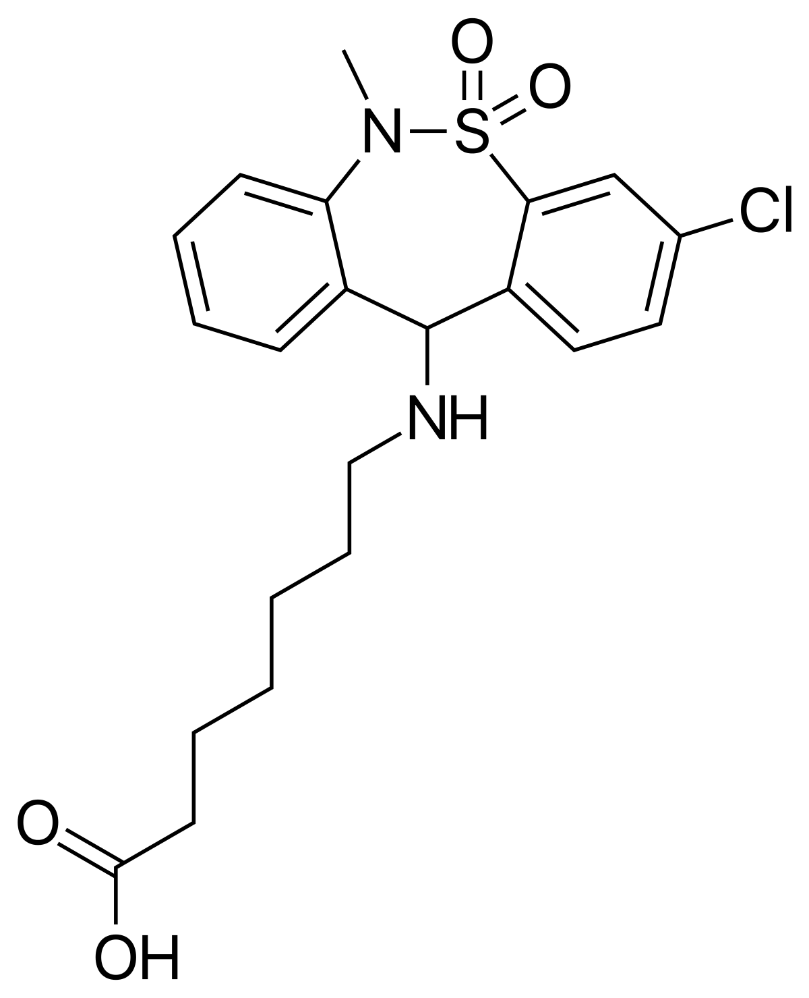
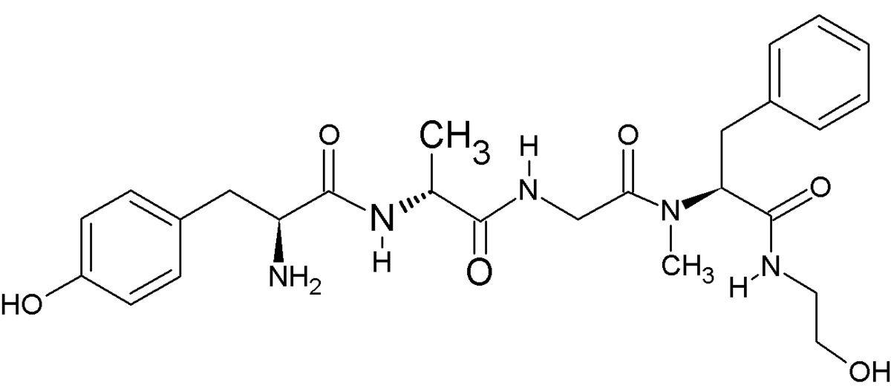
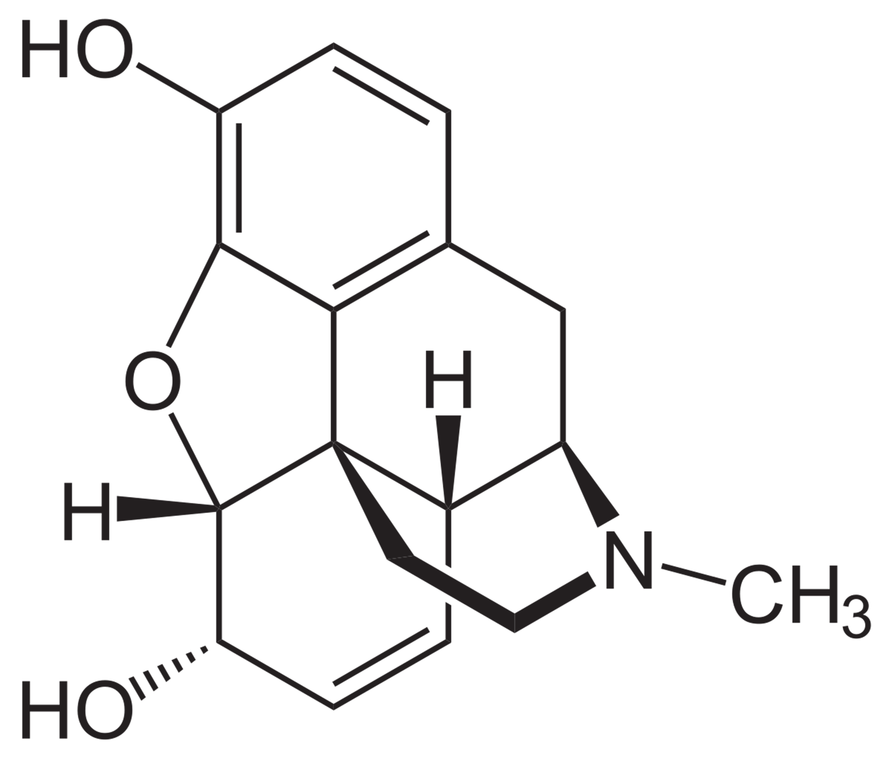
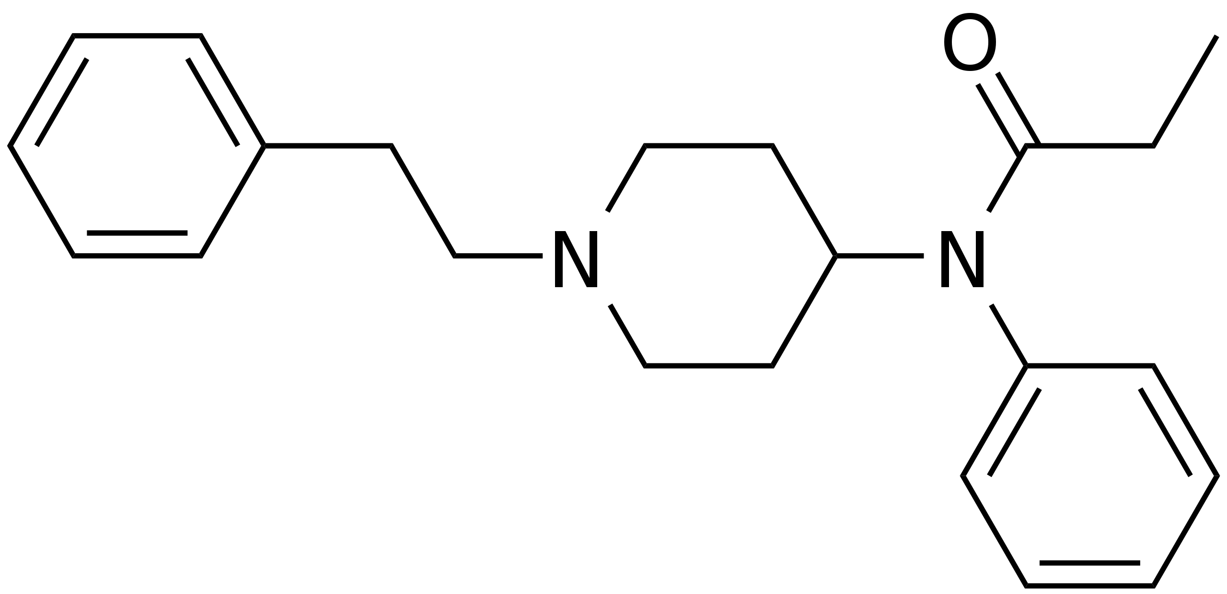
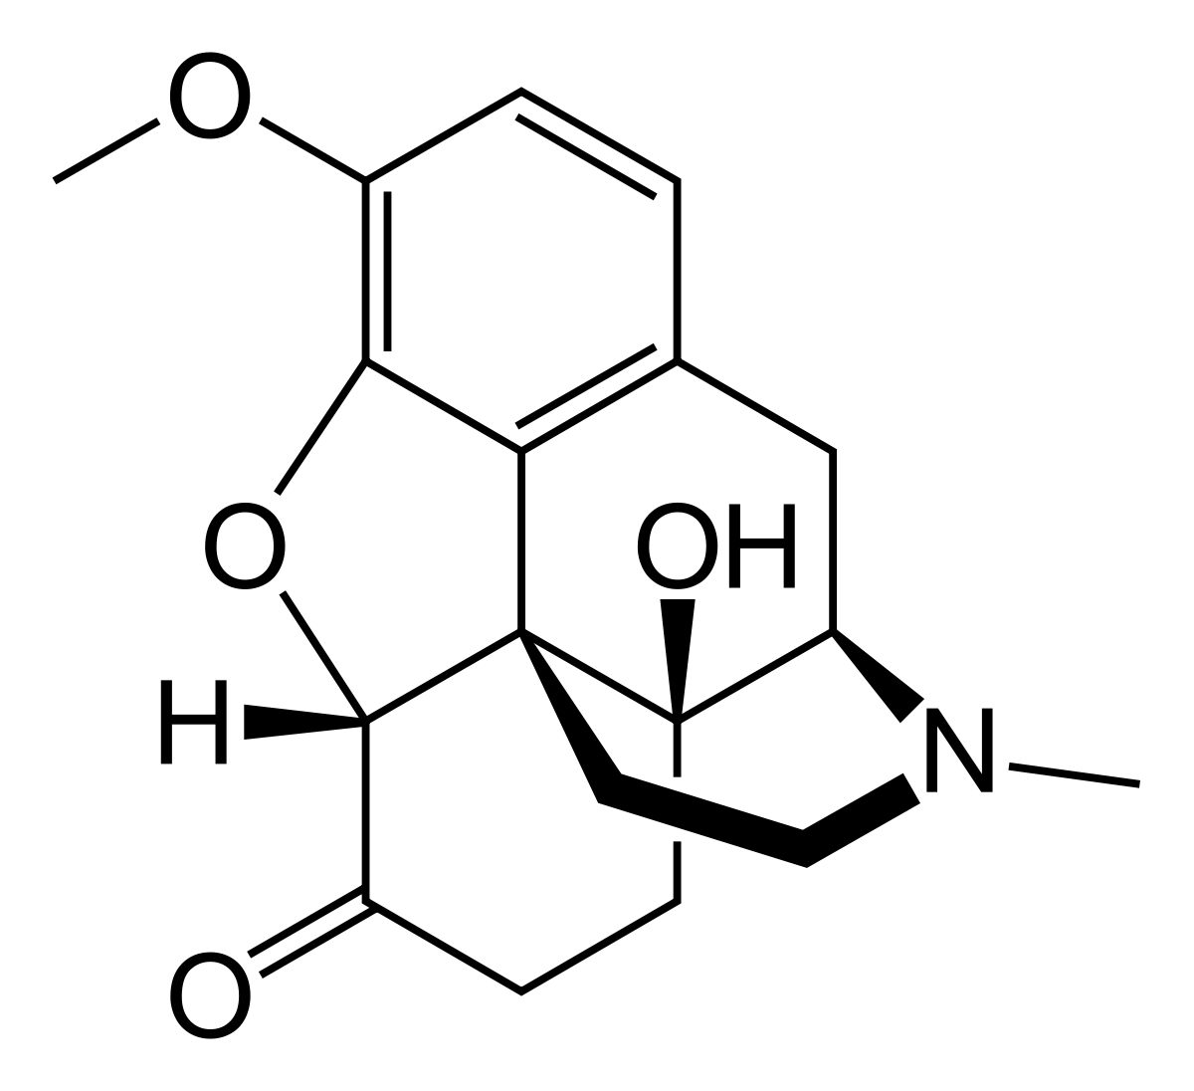
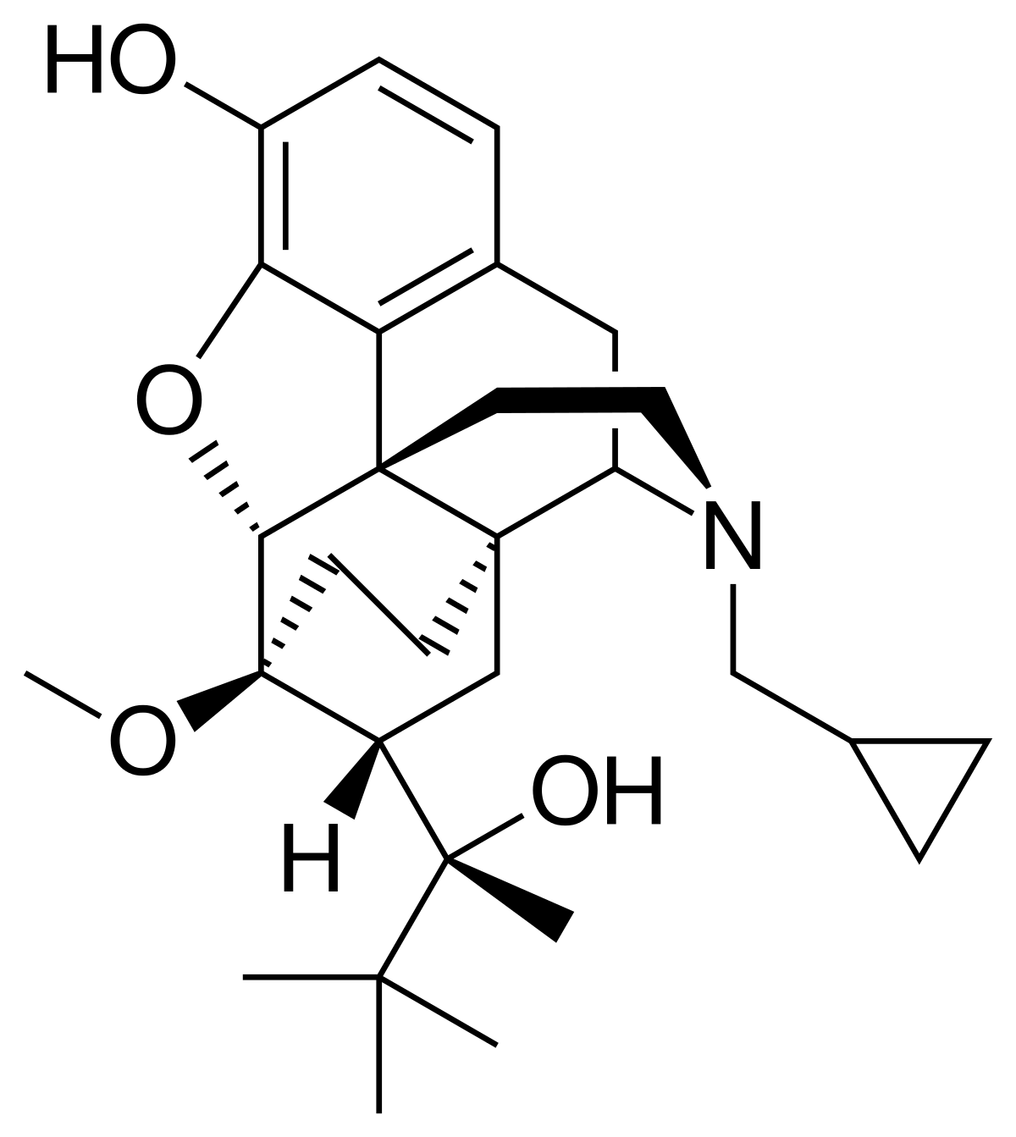
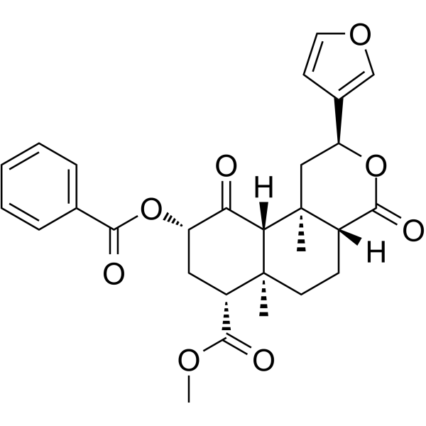
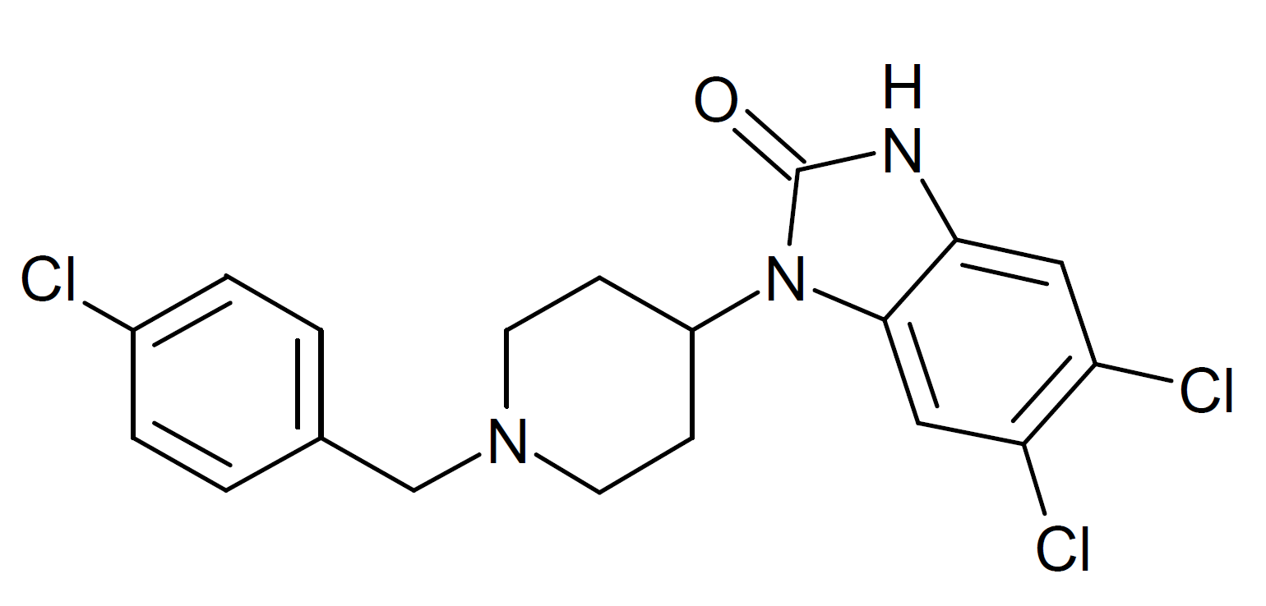
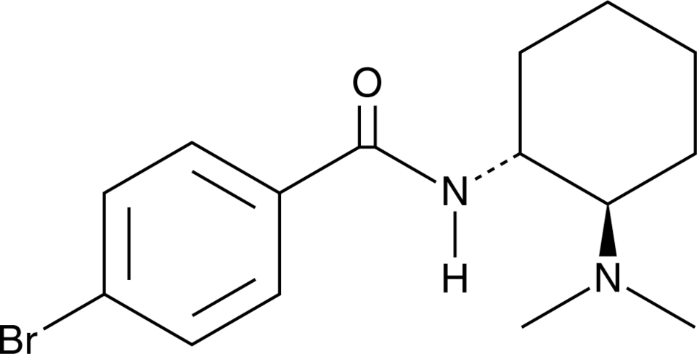
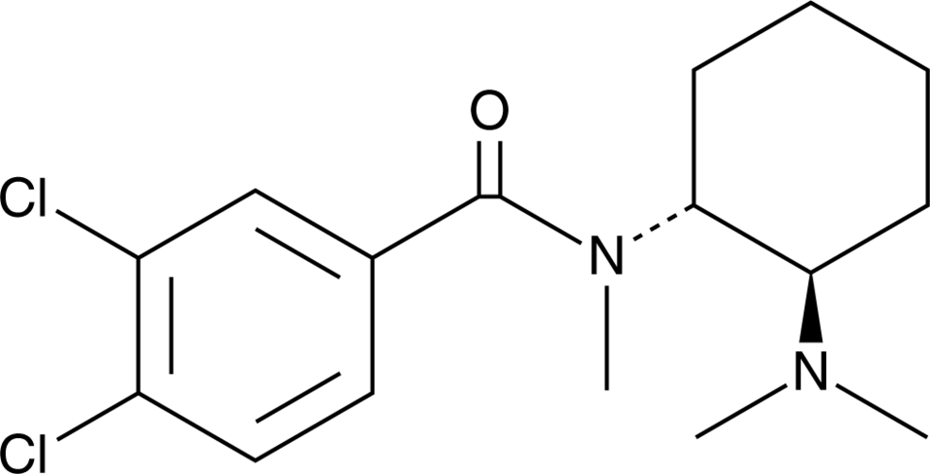
Reconciling differences in stoichiometry reveals lower efficacy
FDA approved 2020
MORPHINE
Does partial agonism also explain the diverse signalling outcomes of whole panels of agonists?
DAMGO (ref)
Morphine
Fentanyl*
Tianeptine
Oxycodone
Buprenorphine*
TRV130**
PZM21**
Herkinorin**
U4791e bromadoline**
U-47700 (U4)
SR-17018**
* Previous designation of bias

Slide 5
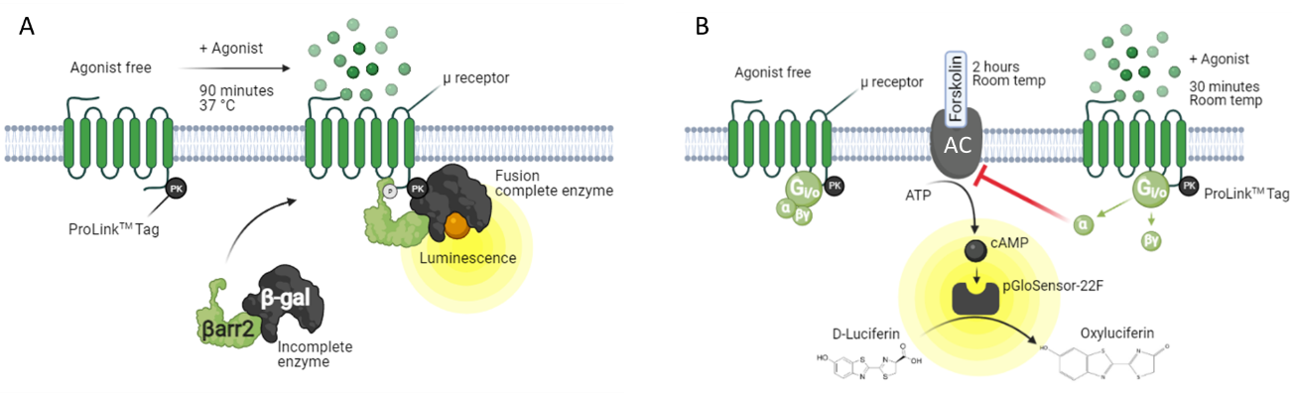
Approaches to measure opioid signalling pathways
Linear β-arrestin2 recruitment assay
Highly amplified cAMP accumulation assay
Human
Efficacies and potencies assessed in Chinese Hamster Ovarian cells stably overexpressing human µ receptors and β-arrestin2
Number of available receptors is reduced by 1-hr exposure to an irreversible antagonist (β-funaltrexamine; β-FNA)

Slide 6
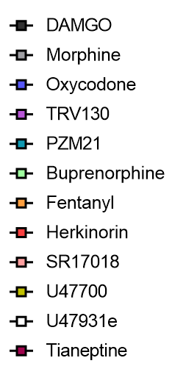
Apparent bias observed in cells with full µ receptor availability
Linear β-arrestin2 recruitment assay
Highly amplified cAMP accumulation assay
Efficacy
Less potent
Potency
Less potent
DAMGO >>>
Tianeptine = fentanyl = morphine = SR-17018 =
Herkinorin = Oxycodone = U47700 >>
U47931e = TRV130 = PZM21 > Buprenorphine
DAMGO = Tianeptine = fentanyl = morphine = SR-17018 =
Herkinorin = Oxycodone = U47700 = U47931e = PZM21 >>
TRV130 > Buprenorphine
Rank
order:

Slide 7
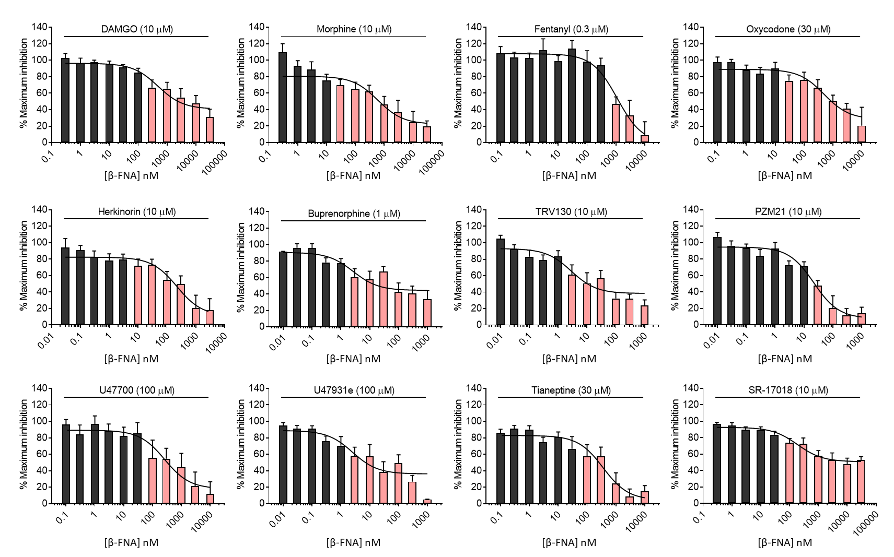

Limiting receptor availability reduces µ agonist efficacy
µ
100 nM <
< 100 nM
100 nM <
< 100 nM
+ β-FNA
µ
< 100 nM
< 100 nM
< 100 nM
< 100 nM
+ β-FNA
µ
+ β-FNA
< 100 nM
< 100 nM
< 100 nM
100 nM <
µ
*** First significant reduction in efficacy from control (0 nM)

Slide 8
Partial agonism revealed by reducing receptor availability
100 nM <
< 100 nM
100 nM <
< 100 nM
µ
+ β-FNA
(100 nM)
< 100 nM
< 100 nM
< 100 nM
< 100 nM
µ
< 100 nM
< 100 nM
< 100 nM
100 nM <

Slide 9
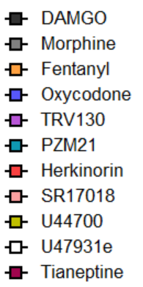
Limiting receptor reserve reveals correlation in efficacy between assays
Full receptor availability
Partial receptor availability
µ
µ
r = 0.56
p > 0.05
r = 0.76
p < 0.05
All agonists able to achieve
similar maximum response
True efficacy

Slide 10
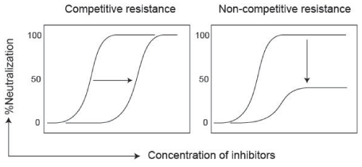
Competitive antagonism reveals distinct activation by SR-17018
Agonist
Antagonist
DAMGO
SR-17018
Same E_{MAX}
cAMP accumulation
Lower potency
If agonist/antagonist are competing for the same site then increasing [agonist] can overcome antagonism.
DAMGO is competing for the same site as cyprodime as is SR-17018
SR-17018 is competing for the same site as DAMGO

Slide 11
Competitive antagonism reveals distinct activation by SR-17018
Agonist
Antagonist
DAMGO
SR-17018
Lower E_{MAX}
β-arrestin2 recruitment
Same potency
If agonist/antagonist are competing for different sites then increasing [agonist] has no effect.
DAMGO is competing for the same site as cyprodime whereas SR-17018 is not
SR-17018 is competing for a different site to DAMGO

Slide 12
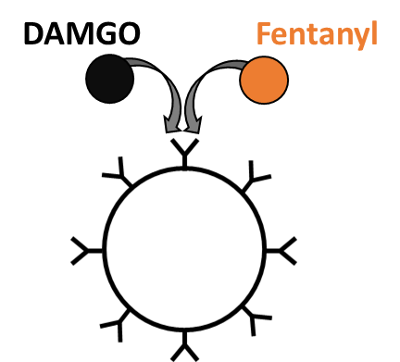
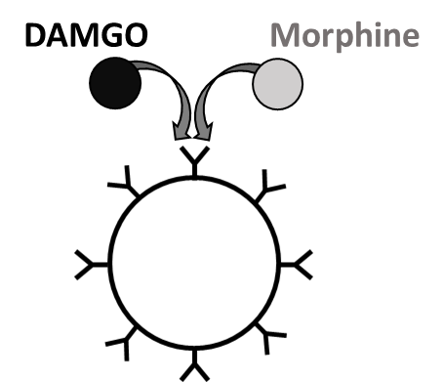
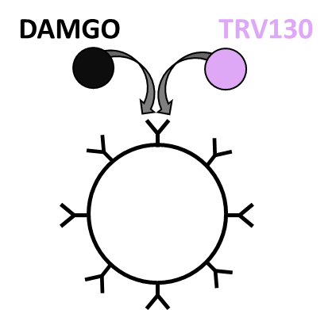
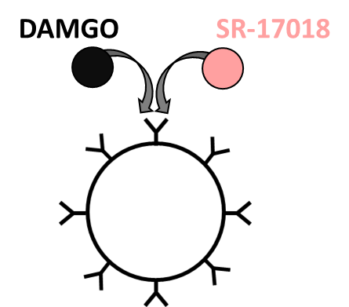
Competitive agonism reveals distinct activation by SR-17018
Fentanyl
Morphine
TRV130
SR-17018
Unlike other orthosteric agonists, SR-17018 fails to compete with DAMGO suggesting a non-competitive activation method

Slide 13
Summary
Agonists appearing as biased (against β-arrestin2 recruitment) have lower efficacy when spare receptors are removed.
Low efficacy can explain the improved side effect of recently developed biased agonists (Gillis et al, 2020; 32234959).
SR-17018 is the most promising novel µ agonist BUT:
  It has characteristic signs of being a partial agonist in vitro
  Causes non-competitive activation (is this bias ?)
  Still causes detrimental effects in mice (Hill et al., 2023; 37489013)
If opioids analogous to SR-17018 are to be exploited clinically it will be important for future studies to test whether its effects are reversed by traditional antagonists e.g, naloxone

Slide 14



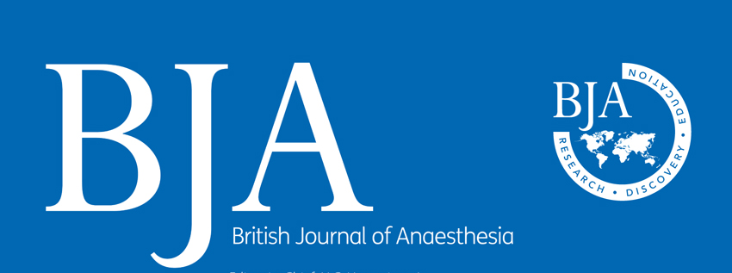

Acknowledgements
TGH Lab contributions:
Professor Tim G. Hales (t.g.hales@dundee.ac.uk)
Dr. Daniel Baptista-Hon (Macau UST, China)
Contributions by:
Clara Dieterle
Dr. David Walker
Andrew S. Oswald
Greta Rosenqvist
Tyko Runeberg
Laura Robertson
Dr. Shuvam Sarkar
Taylor McCarthy

